Slide 1
Jenkins
Email-notification

Slide 2
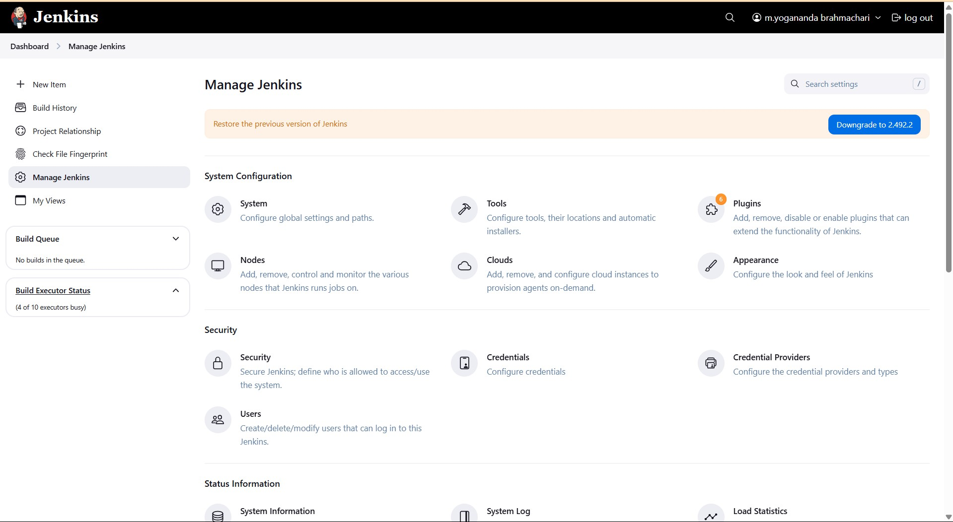
Email configuration

Slide 3
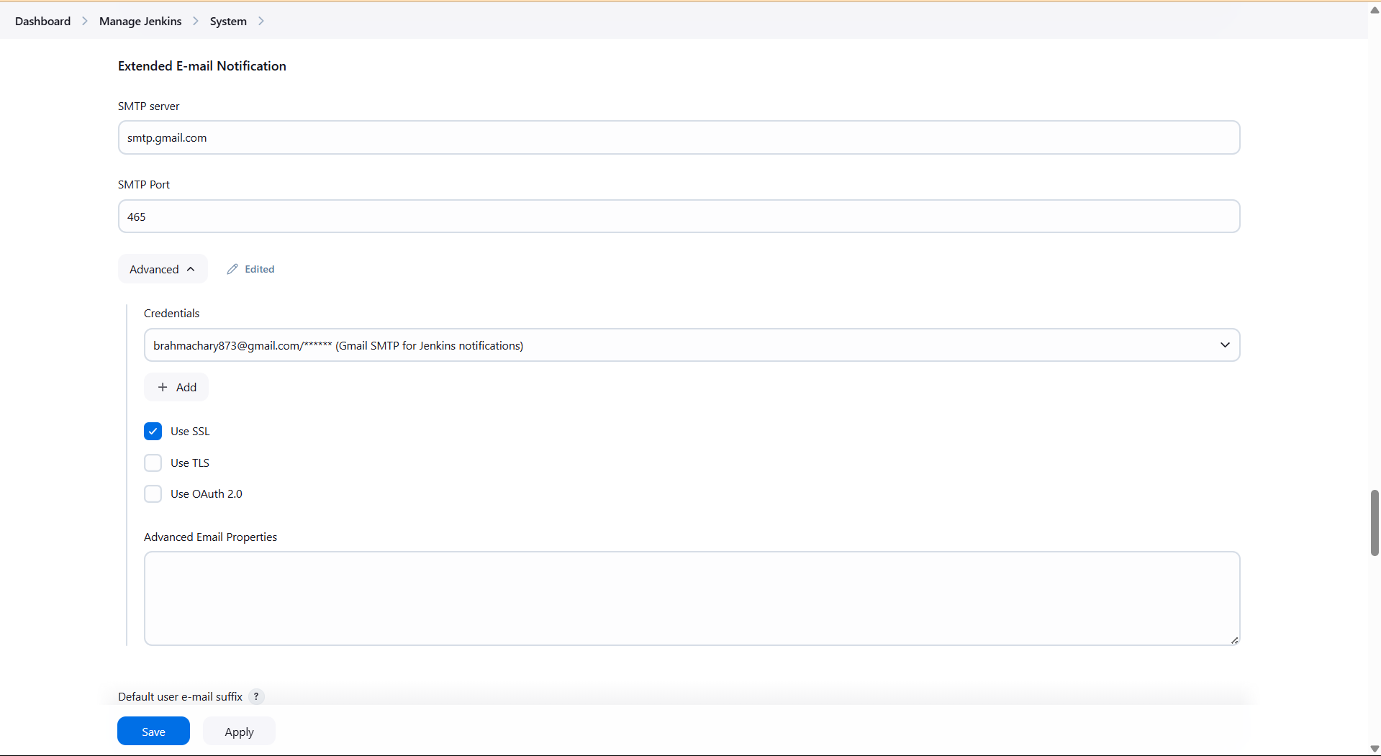
Go to settings

Slide 4
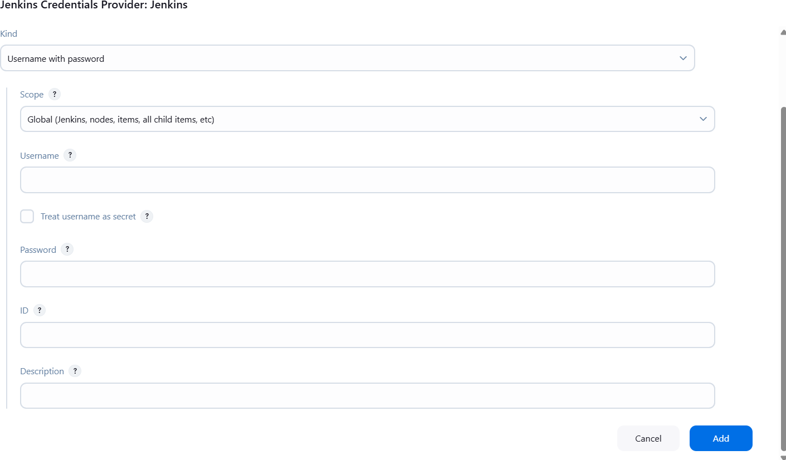
Jenkins credentials

Slide 5

Make the configuration
Kind: Username with password
Scope: Global
Username: your-email@gmail.com
Password: App Password (from https://myaccount.google.com/apppasswords)
ID: gmail-smtp (or any name you’ll remember)
Description: Gmail SMTP for Jenkins notification

Slide 6
Basic pipeline scripting
Pipeline {
Agent any
Stages {
Stage("mention the stage ") {
Steps {
For windows "bat" For linux or Mac "sh"
}
}
}
}

Slide 7
Set Environment
Pipeline {
agent any
Environment {
DOCKER_IMAGE = 'chari9515/html-jenkins-app'
}

Slide 8
Cloning repo
Stages {
Stage('clone Repository') { Steps {
Git branch: 'main' , url : 'https://github.com/3212harsh/html-jenkins-app.git'
}
}

Slide 9
Build a Docker image
stage('Build Docker Image') { steps {
script {
bat "docker build -t ${DOCKER_IMAGE} ."
}
}
}

Slide 10
Push to Docker-Hub
stage('Push to Docker Hub') {
steps {
script {
withCredentials([usernamePassword(credentialsId: 'dockerhub-creds', usernameVariable: 'DOCKER_USER', passwordVariable: 'DOCKER_PASS')]) {
bat "docker login -u %DOCKER_USER% -p %DOCKER_PASS%"
bat "docker push ${DOCKER_IMAGE}"
bat "docker logout"
}
}
}
}

Slide 11
Deploy with Docker compose
stage('Deploy with Docker Compose') { steps {
script {
bat "docker-compose down"
bat "docker-compose pull" bat "docker-compose up -d"
}
}
}
}

Slide 12
Post operation to send email
post {
success {
emailext subject: "Jenkins Build Successful",
body: "Good news! The Jenkins build and deployment were successful.", to: "brahmachary873@gmail.com"
}
failure {
emailext subject: "Jenkins Build Failed",
body: "Oops! The Jenkins build failed. Check the logs.", to: "brahmachary873@gmail.com"
}
}
}

Slide 13
mail
Save and build and check the default mail

